Slide 1


Slide 2

Lord, we praise you, for making all things new in the month of NOVEMBER.......

Slide 3

Come, let us see the Lord's miraculous works and praise report for the month of November 2024

Slide 4
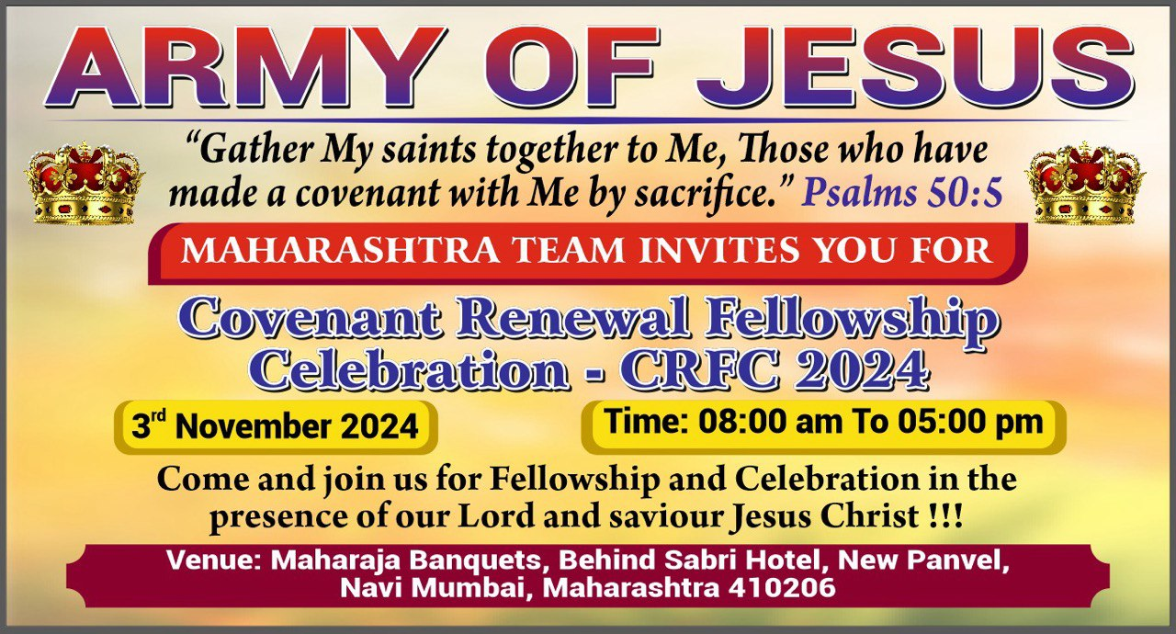
CRFC_Maharashtra State
3rd November 2024

Slide 5
CRFC Meeting held @ New Panvel, Maharashtra
Praise the Lord !!!
By the grace of our Lord and savior Jesus Christ, Maharashtra state’s CRFC meeting was held on 3rd November 2024.
Around 266 members participated (along with children)
Participants attended from various parts of Maharashtra (Mumbai, Navi Mumbai, Thane, Hingoli, Aurangabad, Jalna, Pune, Amravathi , Akola) and also from Karnataka.
Timing: 09:00 AM to 05:30 PM
Language: Hindi and Marathi

Slide 6
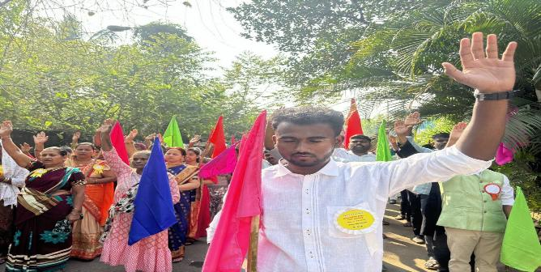
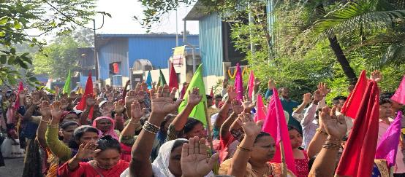
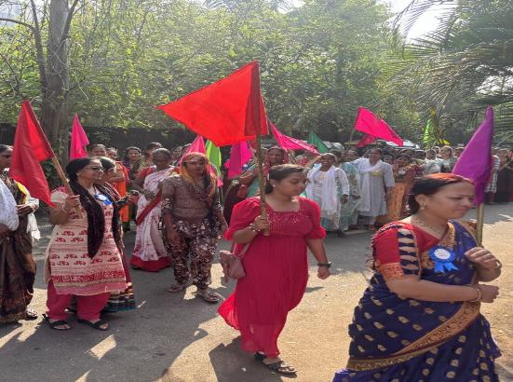
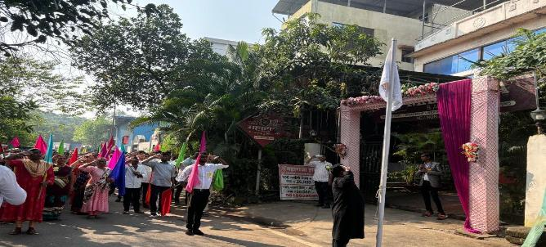
March Past

Slide 7
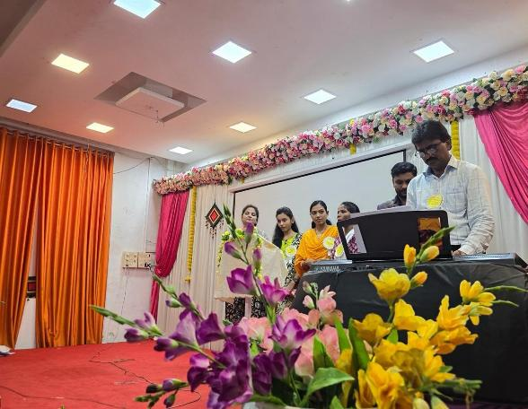
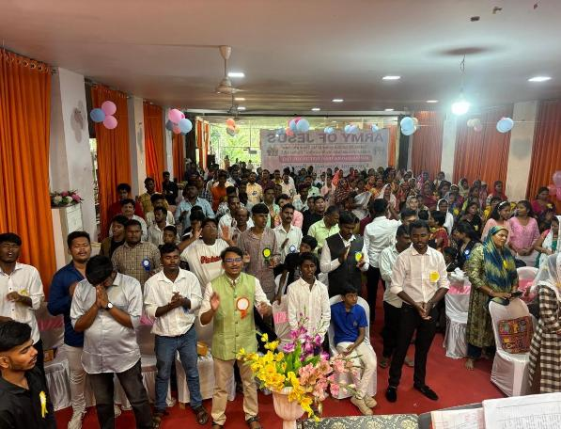
Praise and worship

Slide 8
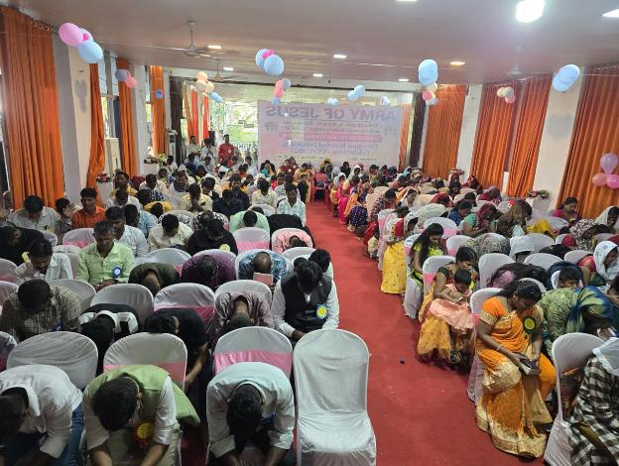
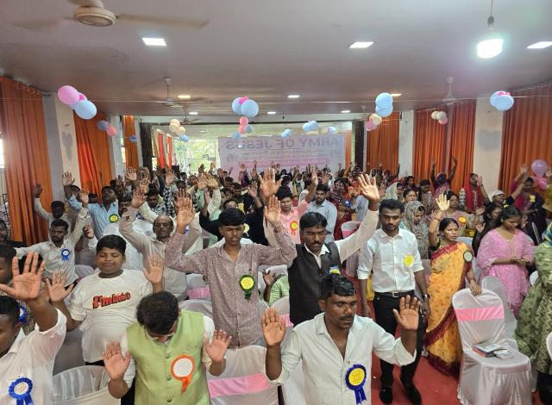
Repentance and commitment

Slide 9
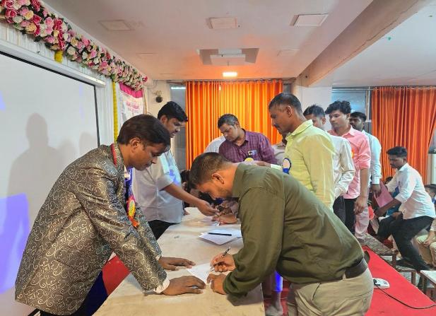
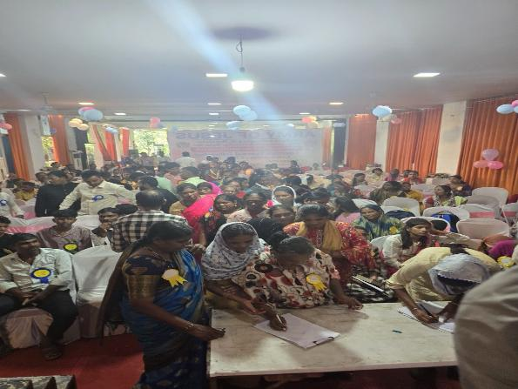
Renewal of covenant

Slide 10
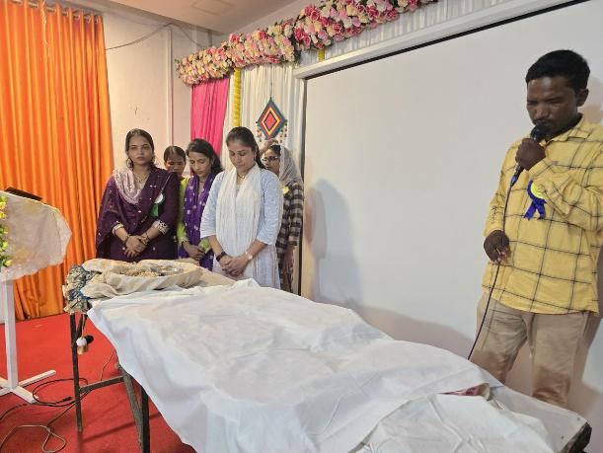
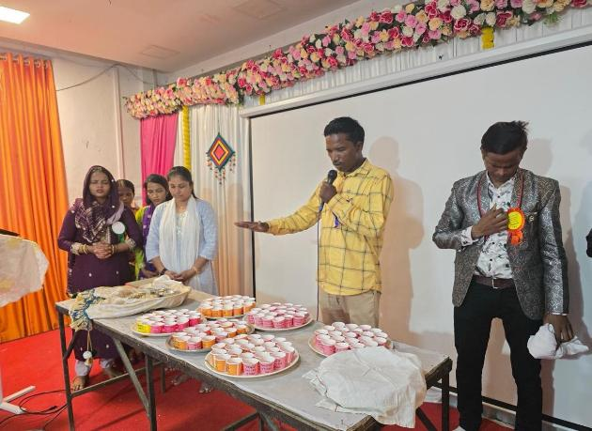
Lord’s supper

Slide 11
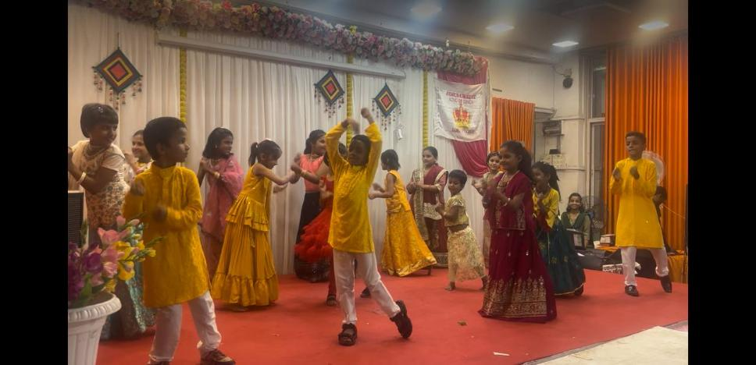
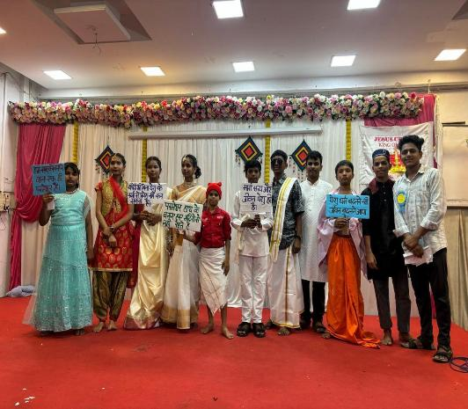
Cultural program’s

Slide 12
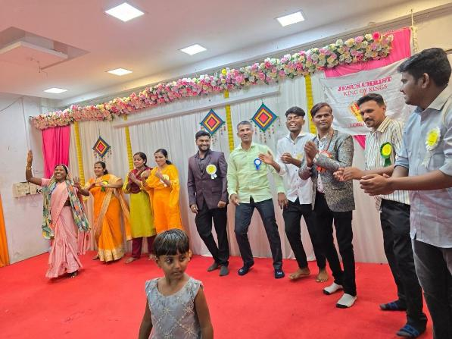
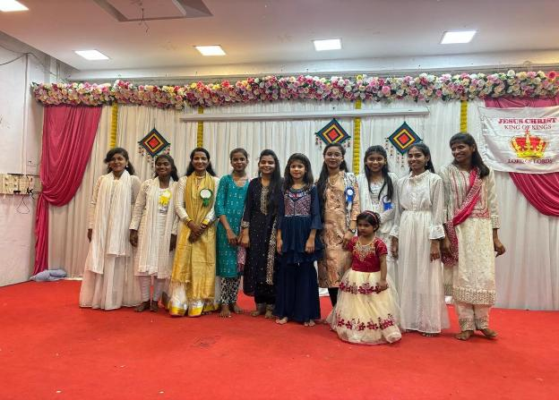
Cultural program’s

Slide 13
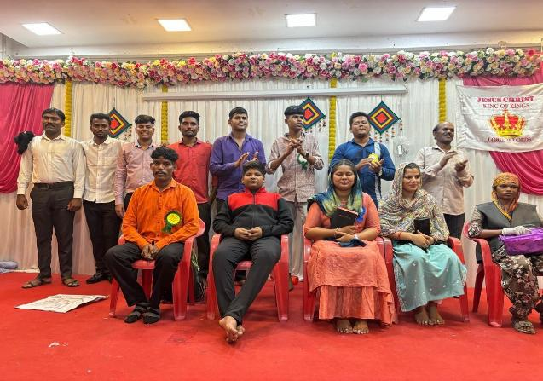
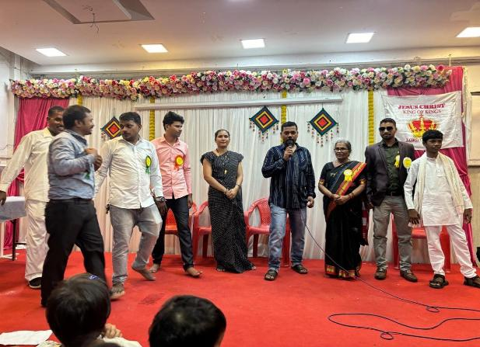
Cultural program’s

Slide 14
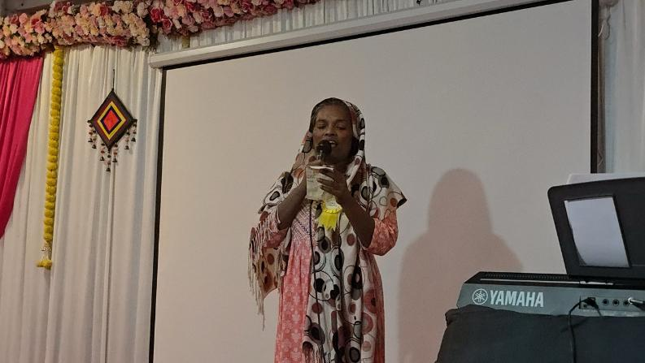
Cultural program’s

Slide 15
Testimonies
For the first time Maharashtra team organized meeting in a large scale, Lord Himself chose and trained ordinary people and equipped His army to execute the works. Ex 35:30
The Lord connected us with the right people who had the talent and gift to do the works.
Breakfast, Tea, Lunch was all prepared by our soldiers and there was no lack nor wastage of any food.

Slide 16
Testimonies
One sister had to shift to her hometown for personal reasons due to which she went far from God. She had a desire in her heart to do something for the Lord, God fulfilled her desire, and she was selected in the worship team, as she worshipped the Lord, she felt that all her bondages are broken, and God has forgiven her and given her a new life.
Another sister saw a vision during the worship, that Lord Jesus is seated on a throne and is very happy with the meeting and all the participants.

Slide 17
Testimonies
One brother felt the presence of the Lord during March past, He saw Jesus' right in front of the army and He Himself is leading all of us as a commander. He also felt that when Jesus is with us, we do not need anyone to lead us.
One sister lost her wallet which had all important ID’s and documents, everyone prayed and prophesied for this, next day morning she received a call from a person, and he returned the purse with all the ID’s and documents.

Slide 18
Testimonies
During repentance and commitment, many saw visions and received revelations from the Lord for them as well as for Maharashtra.
The sister who was leading in renewal of covenant felt dryness in her since many days, however after the renewal of covenant she was filled with Holy spirit and testified that she was able to see visions and experience God like before.
In spite of festival season, more than 60 participants were able to come for the meeting from various parts of Maharashtra.

Slide 19

Troop Church

Slide 20
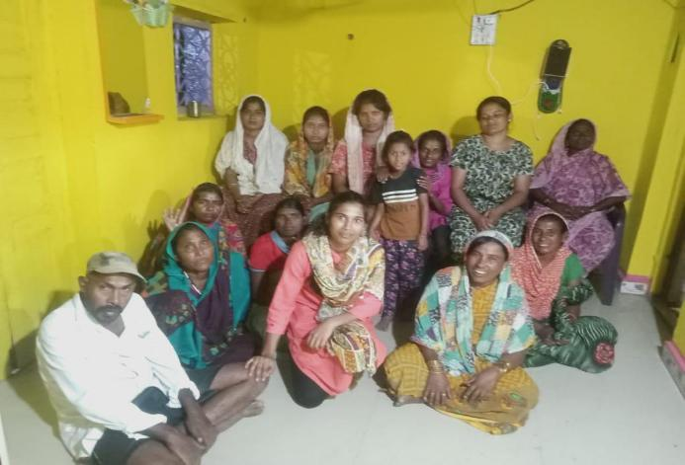
TROOP CHURCH IN MAHARASHTRA (HINGOLI)
Kharbi
Yakub Troop Church
TC Leader - Sol Sunita Kale

Slide 21
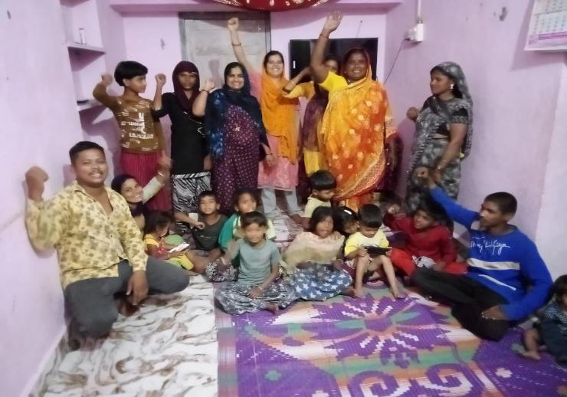
TROOP CHURCH IN (HINGOLI) MAHARASHTRA
Luke troop church
TC Leader - sol SHIVA PAWAR…

Slide 22
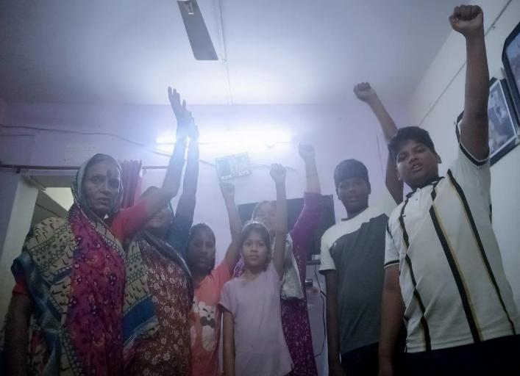
ABRAHAM troop churcH TC Leader - sol SUMAN CHAVAN…
TROOP CHURCH IN (HINGOLI) MAHARASHTRA

Slide 23
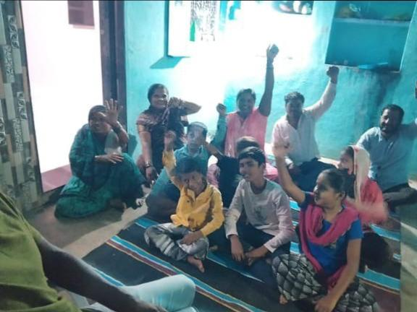
SHELU
DANIEL troop church
TC Leader – sol RADHA Kale
TROOP CHURCH IN (HINGOLI) MAHARASHTRA

Slide 24
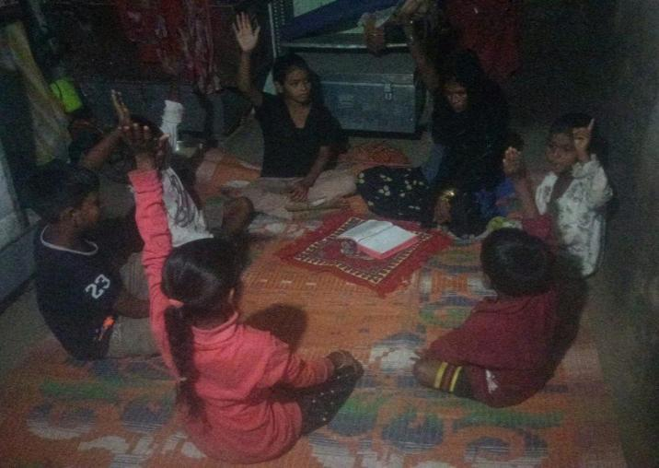
SHELU, MATTHEW troop church
TC Leader - sol REKHA KALE
TROOP CHURCH IN (HINGOLI) MAHARASHTRA

Slide 25
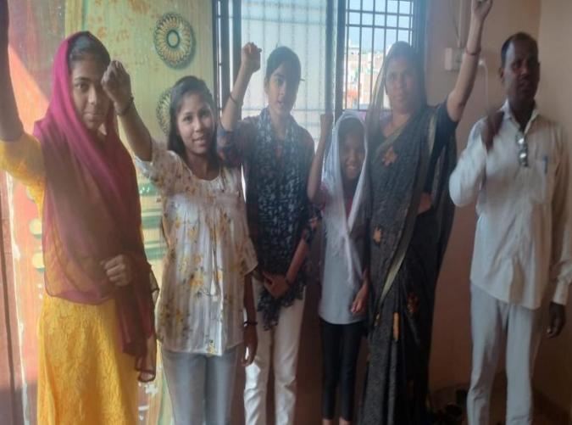
YESHU troop churcH
TC Leader – sol Sahebrao mokkampalle
TROOP CHURCH IN (AURANGABAD) MAHARASHTRA

Slide 26
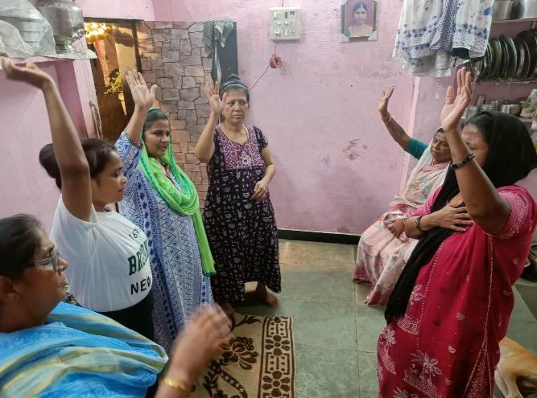
EMMANUEL troop churcH
TC Leader -
SOL- INDIRA & Sol.
CHANDRAKALa
TROOP CHURCH IN (Ghatkopar, MUMBAI)

Slide 27
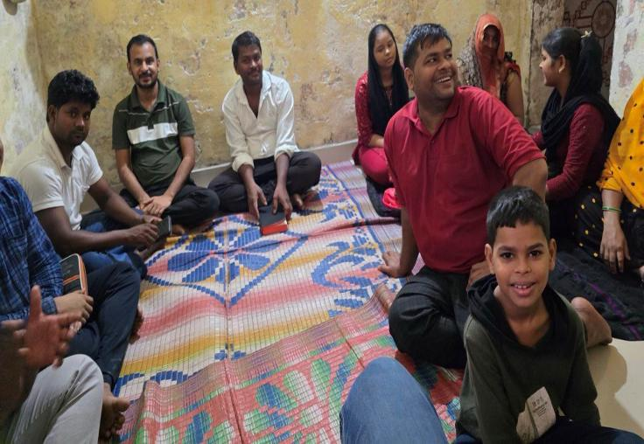
EMMANUEL, troop church
TC Leader -
SOL. JAGDISH Naik
TROOP CHURCH IN Kharghar, Navi MUMBAI

Slide 28
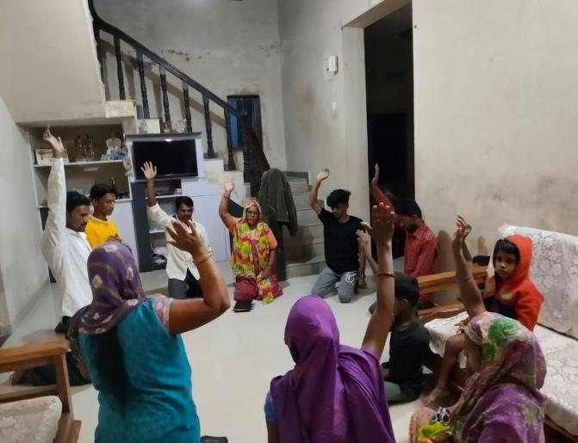
ISAIAH TROOP CHURCH
TC Leader –
SOL- SUNITA
TROOP CHURCH started by BFF students

Slide 29
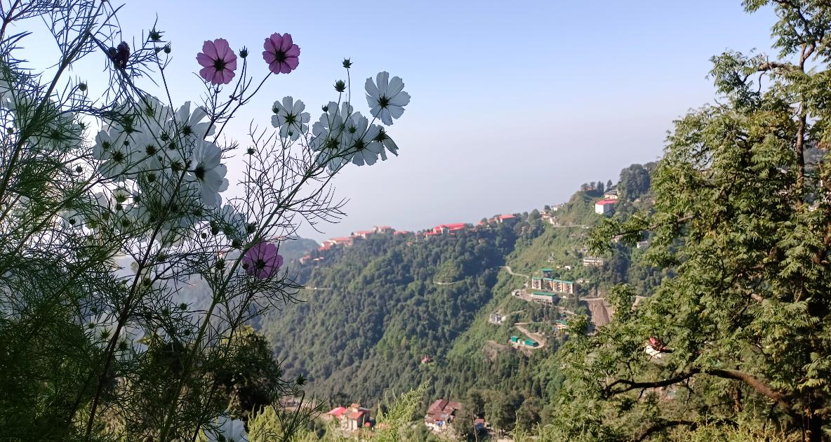
Troop Church’s started in UTTARAKHAND MUSSOORIE by MH soldiers

Slide 30
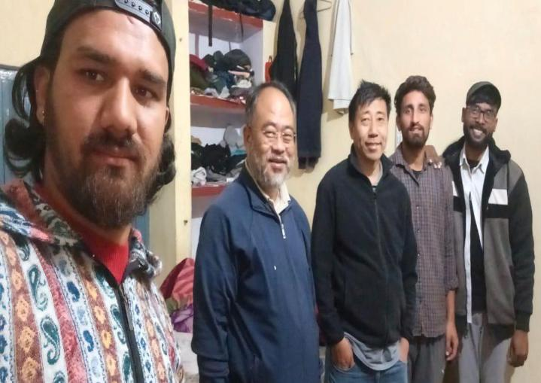
(UTTARAKHAND)
MUSSOORIE
JOSHUA troop church
TC Leader -
SOL- PRATIK FD
TROOP CHURCH IN (UTTARAKHAND)

Slide 31
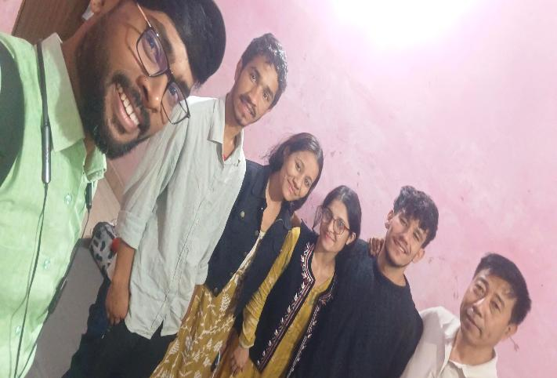
(UTTARAKHAND)
DEHRADUN
ABRAHAM troop church
TC Leader -
SOL- PRATIK FD
TROOP CHURCH IN (UTTARAKHAND)

Slide 32
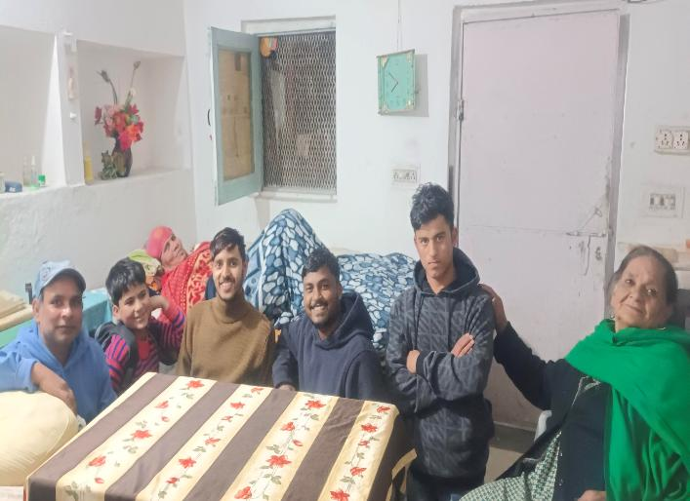
(UTTARAKHAND)
MUSSOORIE
James troop church
TC Leader -
SOL- PRATIK FD
TROOP CHURCH IN (UTTARAKHAND)

Slide 33
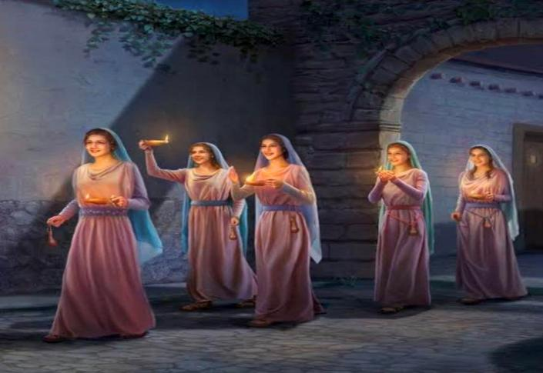
Matthew 26:41 'Watch and pray so that you will not fall into temptation. The spirit is willing, but the body is weak.’
Mark13:33 Be on guard! Be alert ! You do not know when that time will come.
NIGHT PRAYER

Slide 34
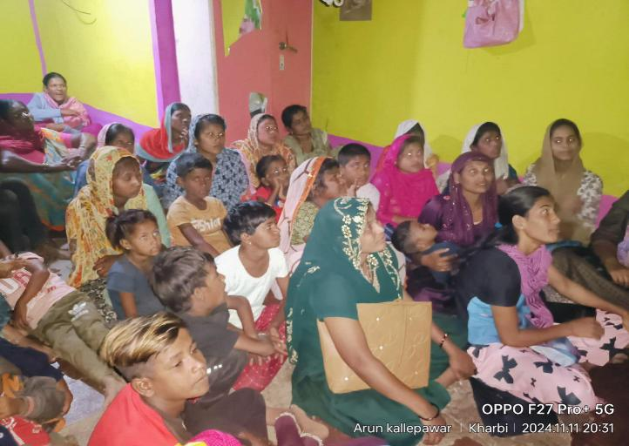
KHARBI GAON
Leader –
SOL- ARUN KALLEPAWAR
MONTHLY NIGHT PRAYER IN (HINGOLI)

Slide 35
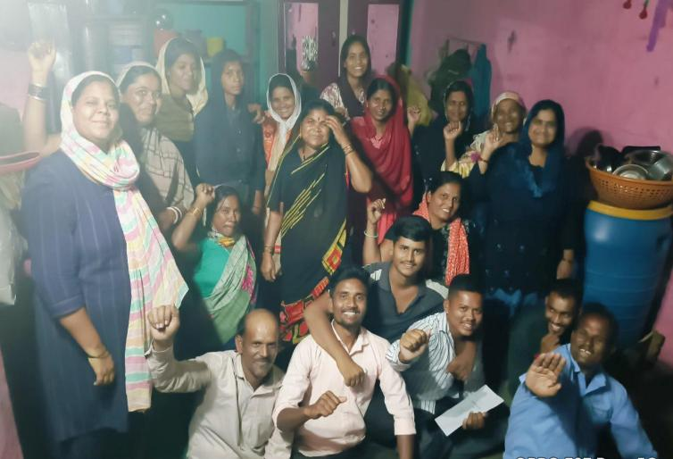
NARSI GAON
Leader –
SOL- ARUN KALLEPAWAR
MONTHLY NIGHT PRAYER IN (HINGOLI)

Slide 36


Slide 37
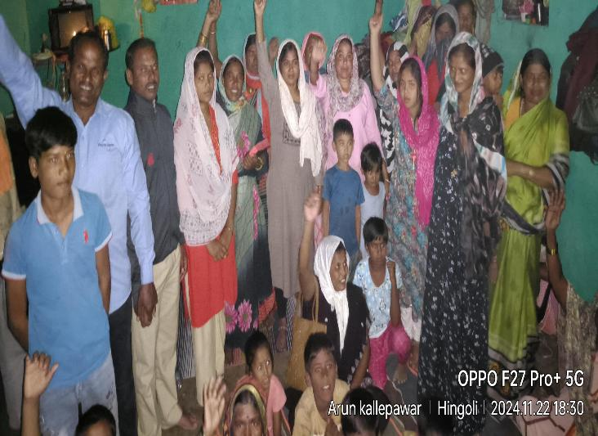
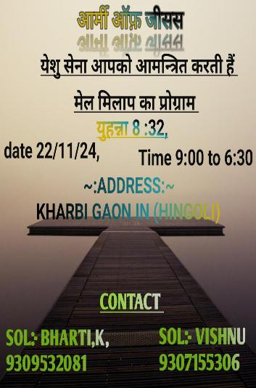
Program of Forgiveness and Reconciliation

Slide 38
1) FRP program in Kharbi, Hingoli district was very successful, 29 people participated in it.
2) This GS was conducted among new believers as well as nonbelievers, many accepted Jesus as Lord and savior that day.
3) They also experienced deliverance and saw the power of God working through forgiveness.
Program of Forgiveness and Reconciliation

Slide 39
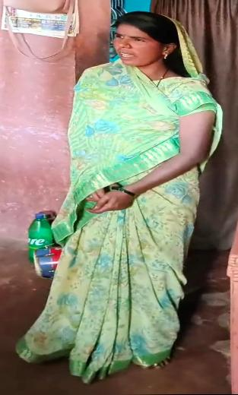
A nonbeliever sister from that village attended the GS, she was suffering from severe stomach pain since many year’s and was taking lot of medicines, however, was not relieved from the pain. As she heard the WOG she was completely healed and delivered from all her bondages.
Next day she testified that she is not taking any medicines and is absolutely healed.
Testimony

Slide 40
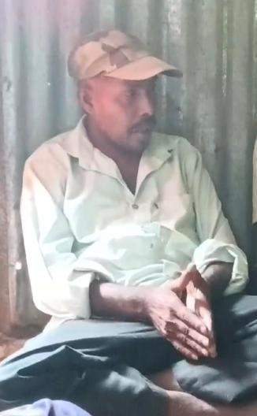
Another nonbeliever brother attended the meeting, he had problem of speech, most of the times he used sign language to communicate and spoke very few words however after attending the GS he regained his speech and started communicating clearly with people. He accepted The Lord and gave thanks to Him.
TesTimony

Slide 41
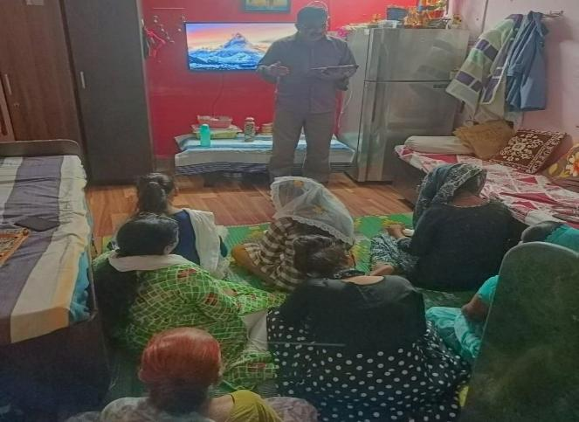
GS was conducted on 23/11/24 TO 24/11/24 at Andheri, Mumbai.
7 people participated
State coordinator – SOL. SUKUMARI
2 DAYS COORDINATOR SOL- SHITAL AND KAVITA
GIFT SCHOOL OF PROPHECY

Slide 42
One sister Elizabeth liked the practical class of Prophesy where she learnt to write decrees. She never knew we have the authority to do so using the WOG, Esther 8:8
One sister Pooja, understood how to differentiate between the voice of HS and voice of satan, she also learnt how to hear the voice of God.
Testimony

Slide 43
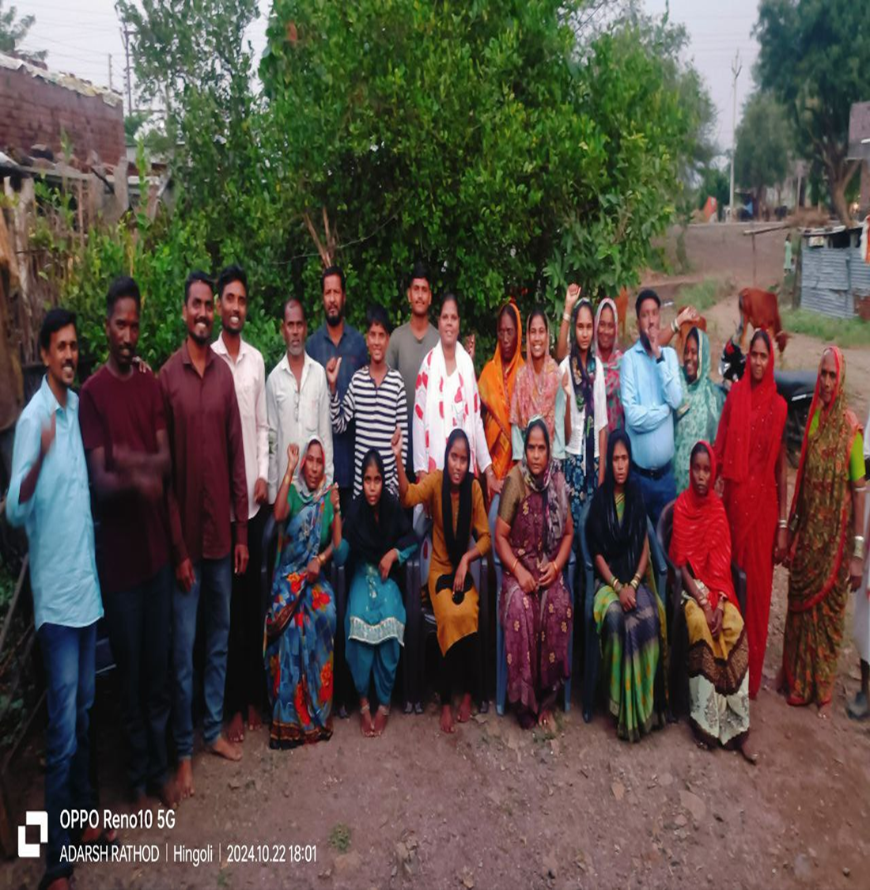
"बनो और बनाओ "
Be Formed And Form (BFF) Batch - 792
Hingoli, Maharashtra
15.10.2024 – 22.10.2024
SOME MEMORABLE EVENTS
Notes:
43

Slide 44
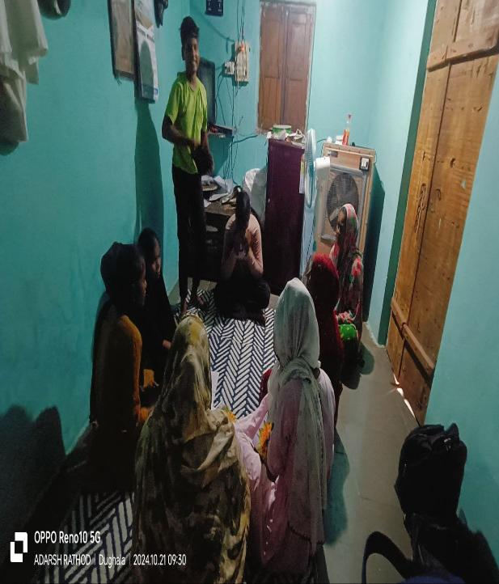
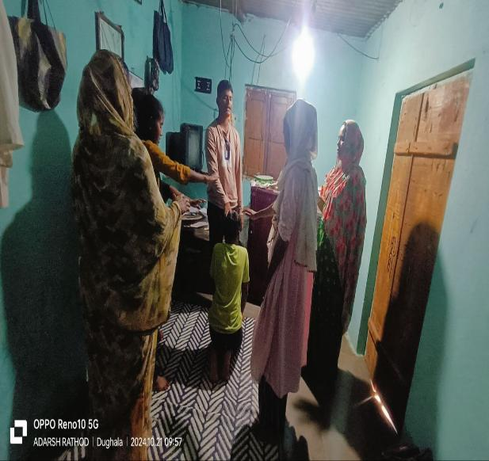
Troop Church

Slide 45
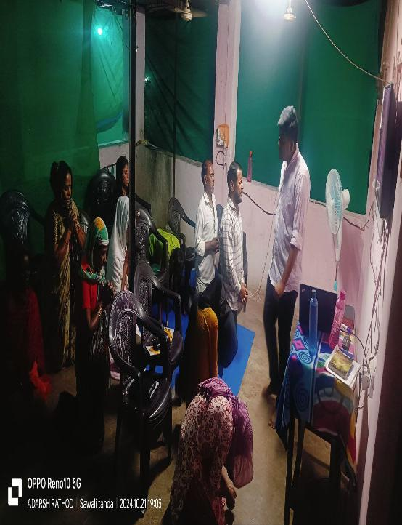
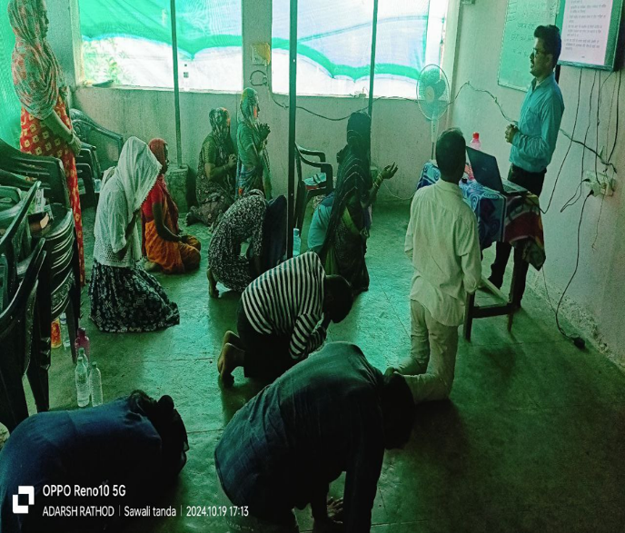
Practical's
God changed Saul’s heart, 1Sam 10: 9)
you will prophesy with them; and you will be changed into a different person.. (1 Sam 10: 6)

Slide 46
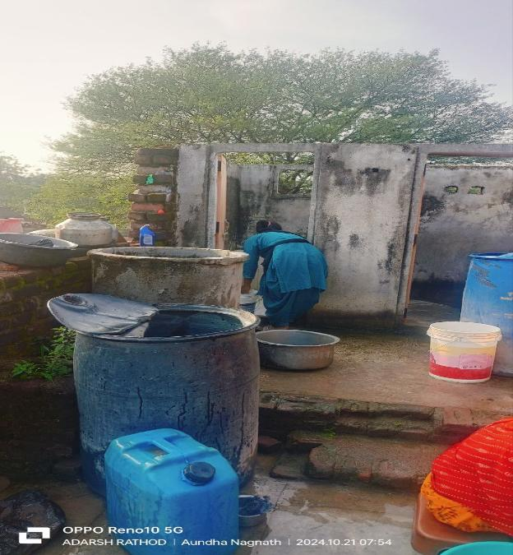
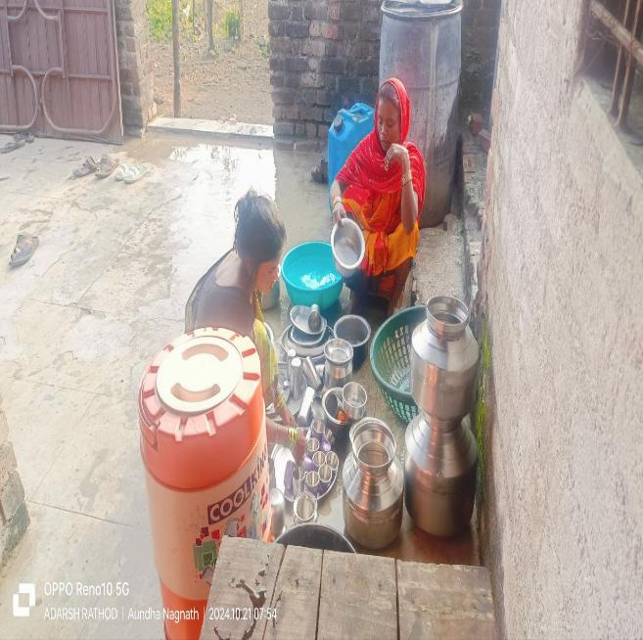
DIGNITY OF WORK – BFF- TRAINING HELPS THE TRAINEES TO EXPRESS THEIR LOVE THROUGH WORK.
THEY INVOLVE IN ALL TYPES OF WORK.

Slide 47
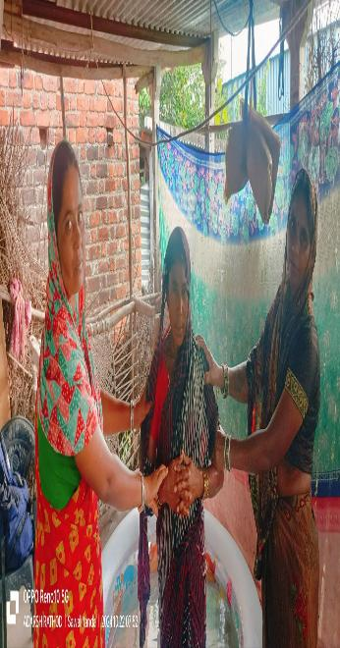
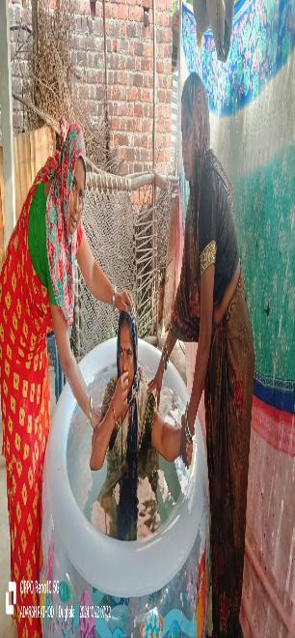


7 sister and 6 brothers took Baptism

Slide 48



Break Time

Slide 49

2 Days Retreat conducted at New Panvel
Date: 30th Nov and 1st Dec 2024
Organizer: MH Core Team
Coordinator: Sol. Lionel Lobo
Participants: 20
Language: Hindi

Slide 50



Slide 51
Testimonies
Almost all the participants were experiencing dryness in them and were not able to have a good relationship with God, however after this retreat they all were revived and got renewed.
Many saw visions and received revelations from the Lord regarding themselves.
Participants also committed to start new troop church and have also adopted new states and countries.
All the classes were very effective and very much required for the participants.

Slide 52


Slide 53

IN MAHARASHTRA
NEXT MONTH Planning …

Slide 54
Next Months Planning
(BFF) | GIFT SCHOOL | TROOP CHURCH | Night Prayer | Fellowship Meetings | MH Retreat
1 | 1 each | 50 | 10 | 10 | 2

Slide 55

THANK YOU JESUS

